Slide 1

Torrero Agronomy
PITCH DECK
Ag Ranking System
Ebad Akhter, Hunter Blum, & Jacqueline Urenda

Slide 2
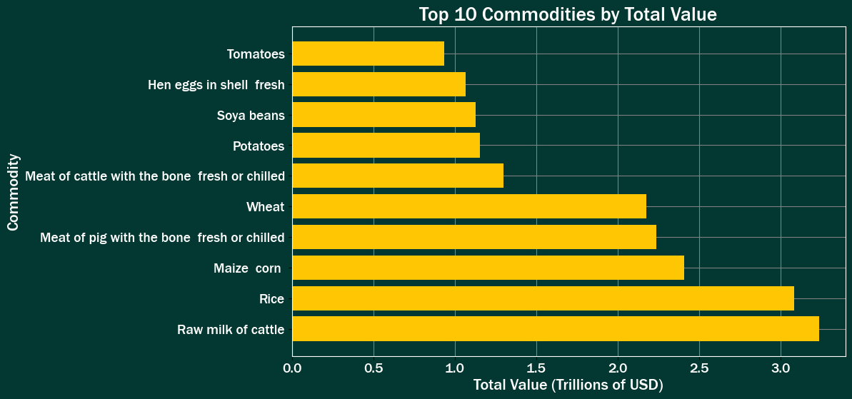
Problem

Slide 3
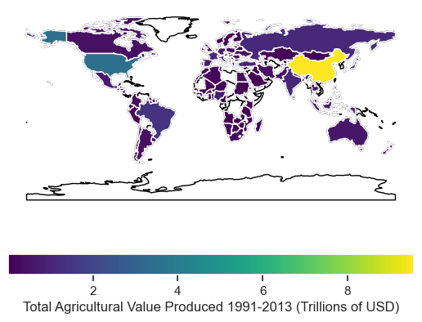
Problem

Slide 4
Implementation - Features
Fertilizer Ratios:
Nitrogen
Phosphate
Potassium
Weather Conditions:
Average Temperature
Average Rainfall
Location:
Latitude
Longitude
Notes:
The variables related to fertilizer inputs were converted into ratios because fertilizers are usually sold with Nitrogen-Phosphorus-Potassium (NPK) ratios on the label. The numeric predictors were standardized in our modeling process to make sure they have the same scale.
To identify the location of each country, we used a function called geolocator from GeoPy, which provided us with the latitude and longitude for each country's geographic center based on the area feature. We then used this data to create maps that showed the total agricultural value, average temperature, average rainfall, and average fertilizer usage (nitrogen, potassium, and phosphate) for each country between 1991 and 2013.
The Average Rain and Average Temperature variables help us understand the connection between a farmer's local weather conditions and the types of crops that grow well in those conditions.

Slide 5
Implementation - Models
Linear Regression
Simple and interpretable.
Assumes a Linear Relationship between variables.
Elastic Net
Prevent overfitting.
Handle datasets with many features.
XGBoost
Prediction accuracy.
Missing data handling.
Linear Learner
Low computational cost.
High-dimensional dataset handling.
Notes:
We chose to create our own models with scikit- learn to establish a baseline. Then we selected the pre-built algorithms to have highly accurate and deployable models.
We used multiple linear regression to predict the total value of crops produced in different countries and years. We then ranked these predictions to establish a starting point for comparison with other models. To account for the different types of crops, we used a technique called one-hot encoding. However, adding too many inputs can lead to overfitting. To avoid this problem, we used another model called elastic net regression, which helps prevent overfitting by using regularization penalties.
We then used two prebuilt Amazon Sagemaker regression models, XGBoost and Linear Learner, to predict the total value of crops produced in different countries and year. We set up the models by defining their properties and training them using our data. XGBoost was particularly useful because it helps prevent overfitting. It can also find patterns in the data that our baseline models could not.
For the Linear Learner model, we hoped to take advantage of a feature that automatically scales the data, making the model more efficient. Overall, these models helped us make more accurate predictions about crop production and value.

Slide 6
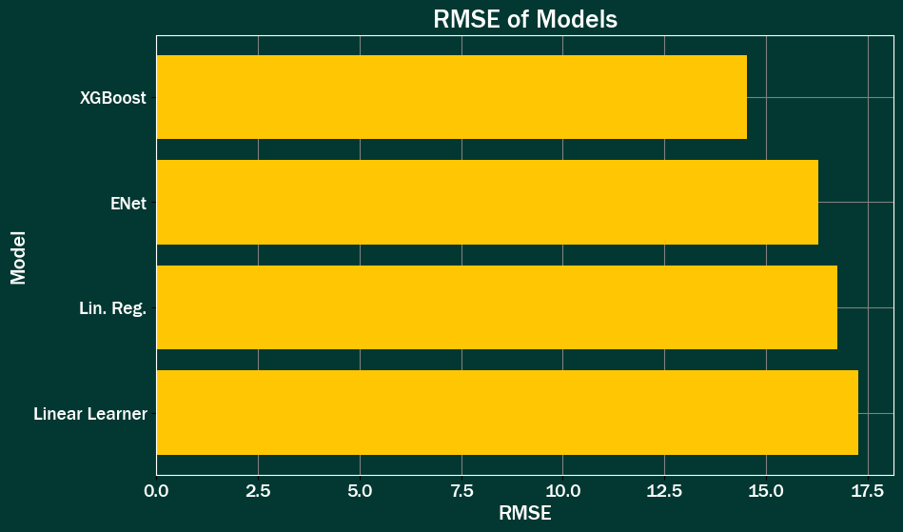
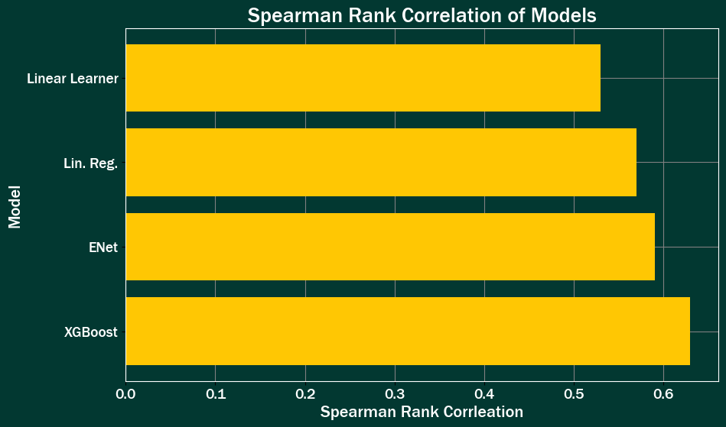

Results

Slide 7
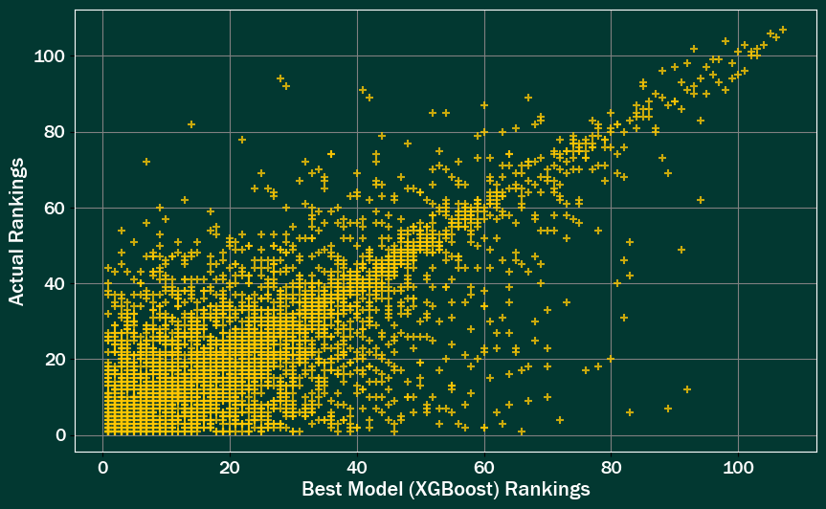
Best Model- XGBoost

Slide 8
Future Enhancements
Data and Feature Collection:
Scale and collect localized data
Identify more key features
Modeling and Autopilot:
Utilize AWS tool Autopilot
Identify better performing models
Individual User Data:
Collect unique user data
Customize rankings & personalize recommendations

Slide 9
Thank You!
References:
Amazon Web Services (AWS). (n.d.). Amazon EC2 Instance Types. Amazon Web Services. Retrieved April 14, 2023, from https://aws.amazon.com/ec2/instance-types/
Food and Agriculture Organization of the United Nations (FAO). (2012). Sustainability and Organic Livestock. Sustainability Pathways: Sustainability and organic livestock. Retrieved March 13, 2023, from https://www.fao.org/nr/sustainability/sustainability-and-livestock
Organization for Economic Co-operation and development (OECD). (2023). How we feed the world today. OECD. Retrieved April 1, 2023, from https://www.oecd.org/agriculture/understanding-the-global-food-system/how-we-feed-the-world-today/
Mishra, S., Mishra, D., & Santra, G. H. (2016). Applications of machine learning techniques in agricultural crop production: a review paper. Indian J. Sci. Technol, 9(38), 1-14.
Mishra, A. (2019). Machine learning in the AWS cloud: Add intelligence to applications with Amazon Sagemaker and Amazon Rekognition. AWS. Retrieved from https://aws.amazon.com/sagemaker/autopilot/?sagemaker-data-wrangler-whats-new.sort-by=item.additionalFields.postDateTime&sagemaker-data-wrangler-whats-new.sort-order=desc
Parikh, S. J. & James, B. R. (2012) Soil: The Foundation of Agriculture. Nature Education Knowledge 3(10):2 https://www.nature.com/scitable/knowledge/library/soil-the-foundation-of-agriculture-84224268/\
United Nations. (n.d.). About Us. United Nations. Retrieved April 8, 2023, from https://www.un.org/en/about-us#:~:text=The%20UN's%20Membership%20has%20grown,members%20of%20the%20General%20Assembly.
Questions: Email hblum@sandiego.edu

